Slide 1

Department of Computer & information Science
TEMPLE
U N I V E R S I T Y
Department of Computer & information Sciences
Nation-wide Community-based Mobile Edge Sensing and Computing Testbeds
Zijie Tang
TEMPLE
U N I V E R S I T Y

Slide 2
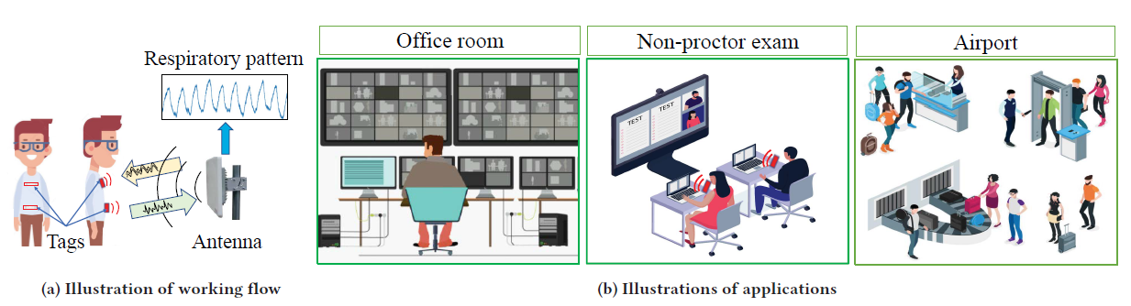
RFID dataset
These datasets were used for the paper "BioTag: robust RFID-based continuous user verification using physiological features from respiration" published in MOBIHOC 2022.
Conference web: https://dl.acm.org/doi/10.1145/3492866.3549718
Conference Version: Hu B, Zhao T, Wang Y, et al. BioTag: robust RFID-based continuous user verification using physiological features from respiration[C]//Proceedings of the Twenty-Third International Symposium on Theory, Algorithmic Foundations, and Protocol Design for Mobile Networks and Mobile Computing. 2022: 191-200.

Slide 3
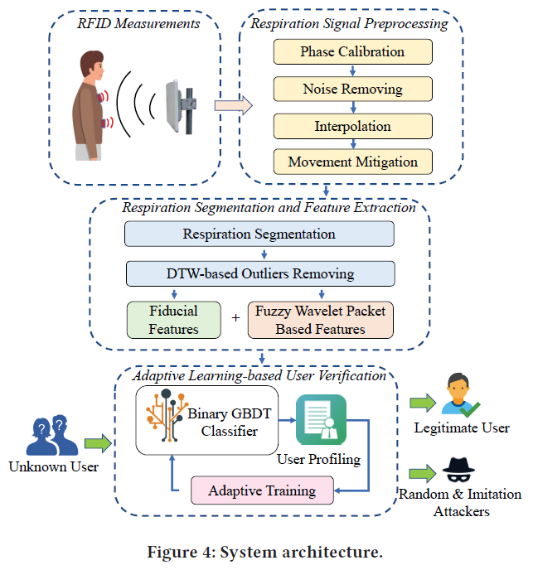
RFID dataset
Description: Our proposed user verification approach “BioTag” captures unique physiological characteristics rooted in the users’ respiration motions by using two RFID tags attached to a user’s chest and abdomen. “BioTag” follows two approaches: 1) it adopts respiratory feature extraction methods based on waveform morphology analysis and fuzzy wavelet transformation (FWPT) to derive unique biometric information from the user’s respiration signals. 2) it trains an adaptive classifier using the gradient boosting decision tree (GBDT) to identify legitimate users and attackers accurately. “BioTag” achieves over 95.2% and 94.8% verification accuracy on random attack and imitation attack scenarios, respectively. To evaluate the performance of “BioTag”, we have created a standard dataset involving 41 participants. The dataset cab be used by fellow research to reproduce the original work or to further explore other machine learning problems in the domain of RFID Signals.

Slide 4
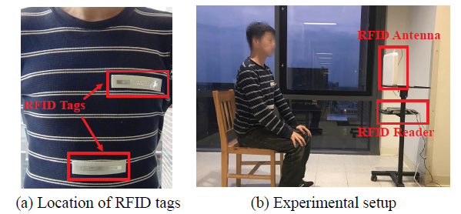
RFID dataset
Experimental Setup:
We attach two RFID tags to a participant’s clothes in the chest and abdomen areas as shown in Figure 3(a). During each experiment, a participant sits on a chair that is 1m in front of the antenna. We keep the antenna at the same height as the participant’s chest as shown in Figure 3(b). Participants are asked to breath normally during the experiments. To evaluate our system’s robustness in different environments, we conduct experiments in four types of indoor spaces including a bedroom with a twin-size bed (4.2m×4.3m), a typical lab with office furniture and (3.0m×5.0m), a corridor with no obstacle (2.8m×2.8m), and a home office with office furniture (7.0m×4.0m).

Slide 5
RFID dataset
Data Collection:
We conduct extensive experiments with 41 participants (i.e., 33 males and 8 females, aging from 12 to 70) for 3 days at different times across 5 months. Each participant take part in 10 experiments, each of which last 60s. We also collect about 200 − 300 respiration segments for imitation attacks, treating 1 participant as a legitimate user and 15 participants as the attackers. Unless mentioned otherwise, we use 70% respiration segments of each legitimate participant for training and the rest of the segments for testing.

Slide 6
RFID dataset
Dataset Description:
We are releasing one datasets: recordings of RFID signal data collected from a commodity RFID reader Impinj R420, equipped with a directional antenna Laird S9028PCL. The RFID signals hop among 50 channels within a spectrum from 902.5MHz to 927.5MHz.
Tag | RSSI | Phase | Time stamp | port | frequency
2 | -42 | 4.718525 | 1.63E+15 | 1 | 902.75
2 | -42 | 4.712389 | 1.63E+15 | 1 | 902.75
1 | -48 | 3.571107 | 1.63E+15 | 1 | 902.75
2 | -42 | 4.718525 | 1.63E+15 | 1 | 902.75
1 | -48 | 3.595651 | 1.63E+15 | 1 | 902.75
1 | -48 | 3.589515 | 1.63E+15 | 1 | 902.75
2 | -42 | 4.736933 | 1.63E+15 | 1 | 902.75

Slide 7
RFID dataset
Dataset Description:
We transfer it to .h5py format and store it as float. The dataset has 8 columns:
Participant Number
Series
Tag
Phase
Amplitude
Time Stamp
Port
Frequency
Website: https://data-website.github.io

Slide 8
RFID dataset
Data Share Website:
1. Figshare
https://figshare.com/ Free accounts on Figshare can upload files of 20GB of free storage.
2. mendeley
https://data.mendeley.com/
3. datadrayad
https://datadryad.org/stash Dryad supports its operation by charging a $120US fee each time data is published.
4. Harvard Dataverse
https://dataverse.harvard.edu/
Harvard Dataverse is free and has a limit of 2.5 GB per file and 10 GB per dataset.

Slide 9
RFID dataset
Data Share Website:
5. Open Science Framework
https://osf.io/
OSF is a free service.
6. Zenodo
https://zenodo.org/
Zenodo has no restriction on the file type that researchers may upload and accepts dataset of up to 50 GB.
7. IEEEDataPort
https://ieee-dataport.org/submit-your-dataset
1950$ 2TB for individual users.

Slide 10
PPG dataset
These datasets were used for the paper "PPG-based Finger-level Gesture Recognition Leveraging Wearables" published in INFOCOM 2018.
Conference web: https://ieeexplore.ieee.org/abstract/document/8486006
Conference Version: T. Zhao, J. Liu, Y. Wang, H. Liu and Y. Chen, "PPG-based Finger-level Gesture Recognition Leveraging Wearables," IEEE INFOCOM 2018 - IEEE Conference on Computer Communications, 2018, pp.

Slide 11
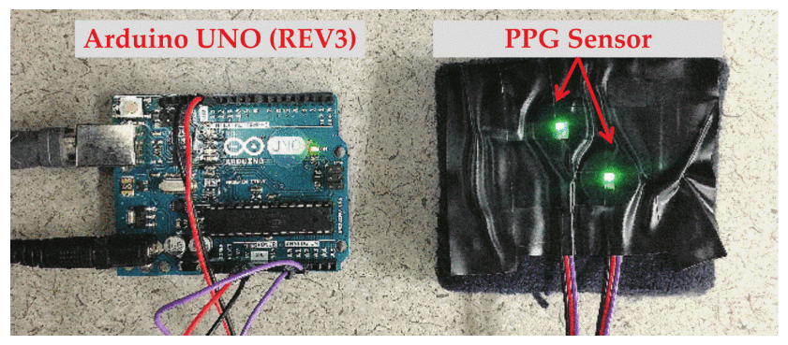
PPG dataset
Wearable Prototype:
we design a wearable prototype that mimics the layout of PPG sensors in commodity wearables to demonstrate that our system can be applied to the existing wearable products without extra efforts. Our prototype consists of two commodity PPG sensors (with single green LED) and an Arduino UNO (REV3). The sensors are closely placed to each other and fixed on the inner side of a wristband, so that it reduces the movements of sensors and ensures our system to take sensor measurements at similar locations in different experiments. In the experiments, we adopt various sampling rates (i.e., 30Hz to 100Hz) to evaluate the system. Unless mentioned otherwise, the default sampling rate is set to 100Hz.

Slide 12
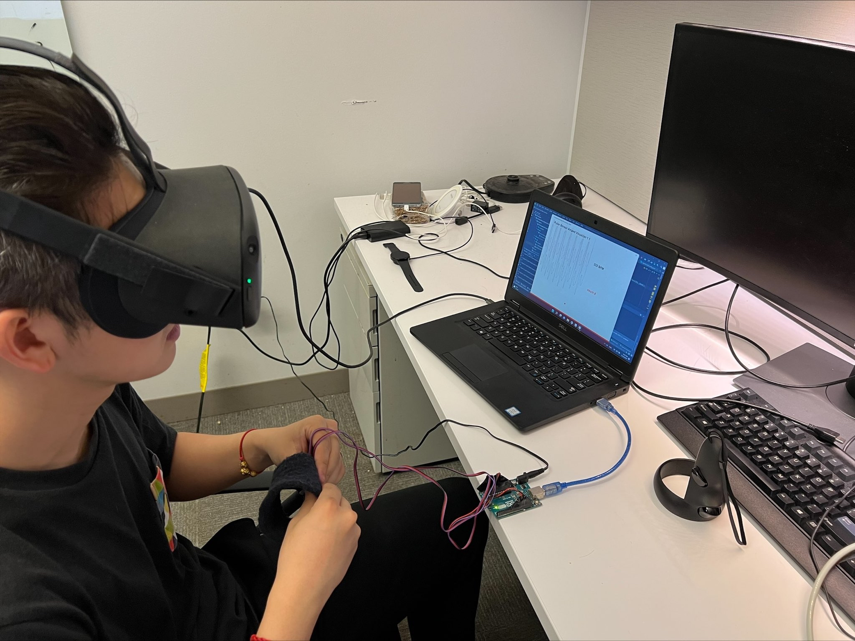
RFID dataset
Data Collection:
We recruit 10 participants including 9 males and 1 female whose ages are between 20 to 30 to perform finger-level gestures for evaluation. We focus on the elementary gestures from American Sign Language involving movements of fingers from a single. The participants are asked to respectively perform the nine finger-level gestures for 40 times while wearing our wearable prototype on the right wrist. Note that our system can be applied to other more complicated finger-level gestures on whichever wrist regardless of the posture of the hand since different gestures involve different combinations of muscle movements that can be captured by our system. In total, we collect 3600 PPG segments for the experimental evaluation.

Slide 13
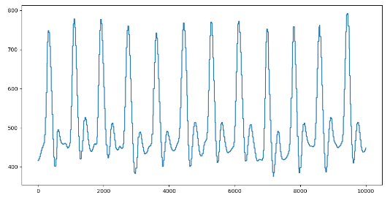
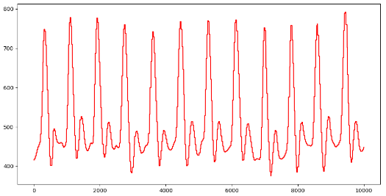
RFID dataset
Data Collection:
In total, we collect 3600 PPG segments for the experimental evaluation.

Slide 14
RFID dataset
Dataset Description:
We transfer it to .h5py format and store it as float. The dataset has 5 axis:
Participate Number
Trails
Tag
Amplitude
Time Stamp

